Slide 1
Inventory Optimization and Sustainability Analysis
-Mannat Arora

Slide 2
Objective
Minimize waste by optimizing inventory levels.
Identify the most efficient purchasing strategies based on sales, procurement, and inventory data.
Evaluate product sales performance to formulate a sustainable inventory management approach.

Slide 3
Methodology
1. Data Preprocessing:
Consolidate all CSV files into a unified master dataset.
Screen for any missing or erroneous entries.
Standardize date formats for consistent time series analysis.
2. Inventory Analysis:
Assess inventory status at the year's start and end using BegInvFINAL12312016.csv and EndInvFINAL12312016.csv.
Pinpoint products with the highest and lowest inventory presence.
3. Sales Analysis:
Examine SalesFINAL12312016.csv to identify bestsellers and products with sluggish sales.
Analyze sales trends over time, considering variables such as sales quantity, sales price, and date.
4. Purchasing Analysis:
Evaluate procurement activities using PurchasesFINAL12312016.csv and InvoicePurchases12312016.csv.
Investigate purchase volumes from different suppliers, procurement costs, and supply chain processes.
5. Optimal Stock Level Calculation:
Determine the optimal stock level for each product by leveraging sales, procurement, and inventory data.
Propose stock levels tailored to the sales velocity of products and supply lead times.

Slide 4
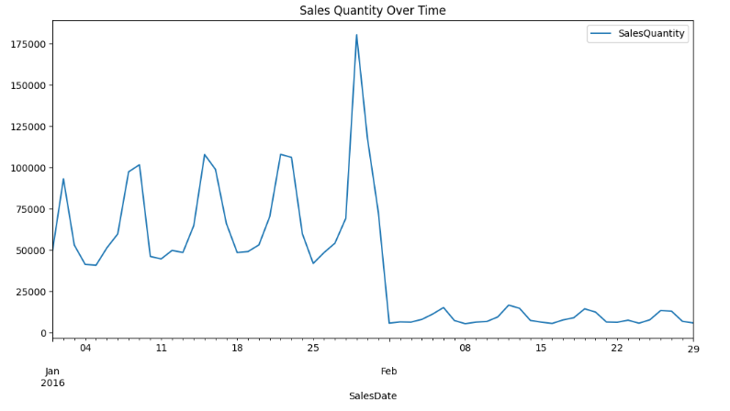
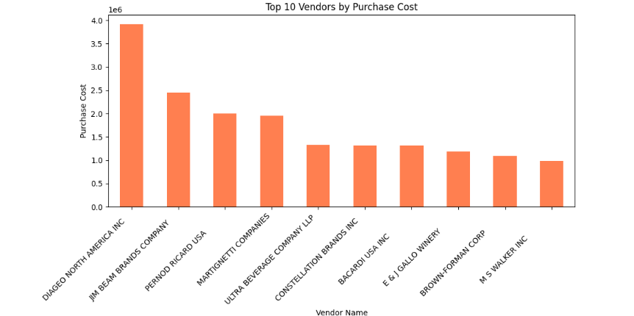
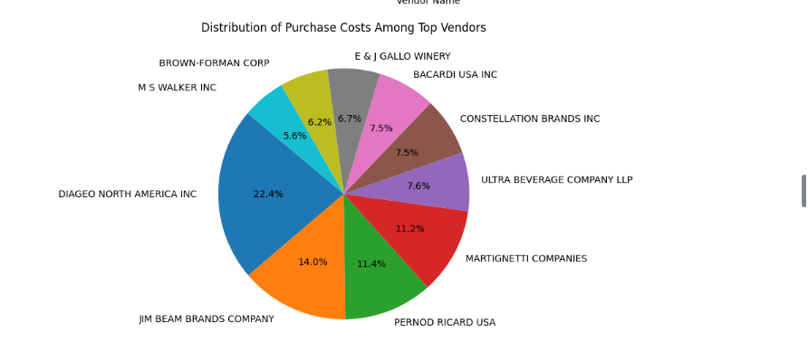
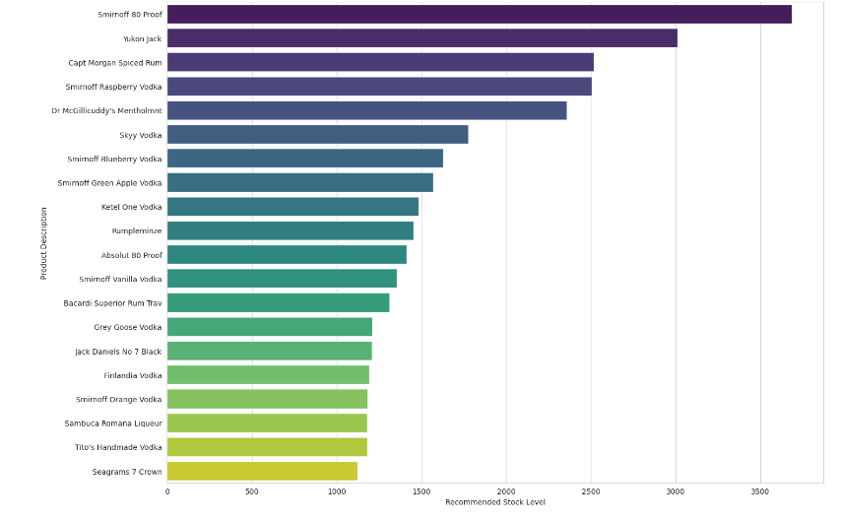

Slide 5
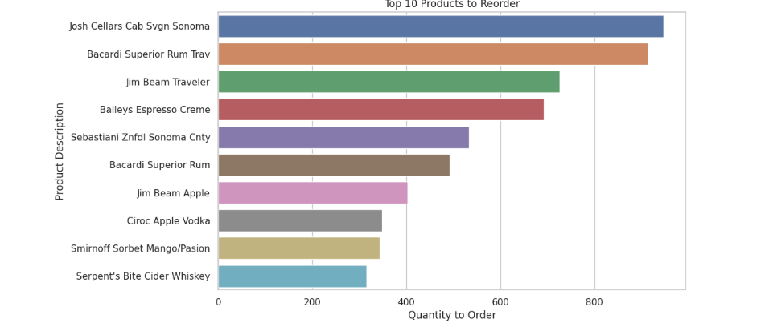
Output Data
The bar graph displays the top 10 products that need to be reordered based on inventory data. The products are sorted by the quantity that needs to be ordered, which is determined by the difference between the recommended stock levels and the current stock on hand. If the current stock is below the recommended level, the product appears on the list with the quantity to order represented on the x-axis.
From the graph, we can observe the following:
The product "Josh Cellars Cab Svgn Sonoma" has the highest quantity to reorder, approaching the 800-unit mark.
"Bacardi Superior Rum Trav" and "Jim Beam Traveler" follow next with slightly less quantity to order, both near or above the 600-unit mark.
Other products like "Baileys Espresso Creme" and "Sebastiani Znfdl Sonoma Cnty" are in the middle range with quantities to order around 400 units.
The product with the least quantity to reorder among the top 10 is "Serpent's Bite Cider Whiskey," which is just below the 200-unit mark.

Slide 6
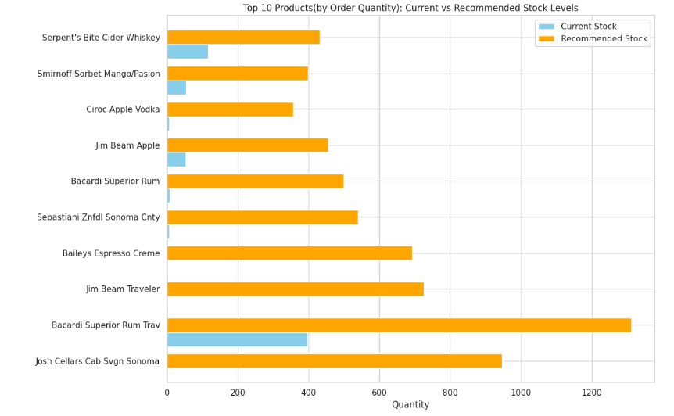
The graph titled "Top 10 Products (by Order Quantity): Current vs Recommended Stock Levels" shows that for all top-selling 10 products, the current stock (blue) is below the recommended stock levels (orange), indicating a need for restocking to meet the suggested inventory.

Slide 7
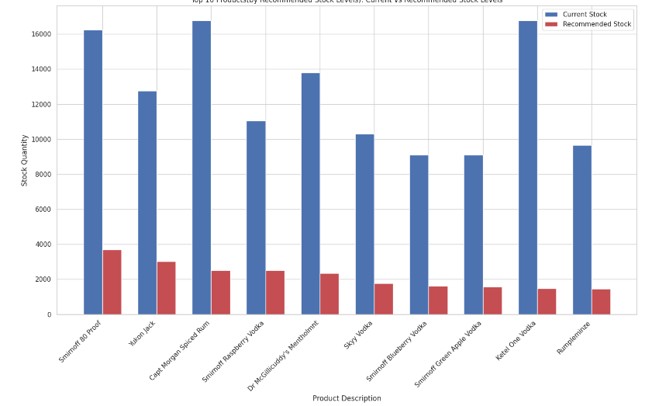
This inventory review highlights a significant surplus in the current stock levels when compared with the recommended stock levels for the top 10 products, sorted by the recommended quantity. Notably, "Ketel One Vodka" and "Rumpleminze" showcase a pronounced excess beyond the suggested inventory, suggesting inefficiencies in stock management. The presence of stock quantities exceeding recommended levels across all observed items may lead to higher carrying costs and risk of stock becoming outdated. Immediate measures such as revising purchase orders and aligning with sales projections are advised to mitigate the risks associated with overstocking and to optimize the stock turnover ratio.

Slide 8
Conclusion
1) Top Products & Trends:
"Ketel One Vodka" soared from 4th to the top, hinting at surging demand.
"Capt Morgan Spiced Rum" finished a close second, just one unit behind.
"Smirnoff 80 Proof" held its ground despite a rebranding, shifting from number 3876 to 8111.
"Absolut 80 Proof" slightly dropped in rank, remaining strong.
Newcomer "Jack Daniels No 7 Black" broke into the top 5.
2) Inventory Challenges:
Zero inventory items at year's start and end suggest stocking or demand issues.
Low-stock items show unpredictable inventory levels.
Specialty items, like select wines, linger at the bottom, indicating niche demand.

Slide 9
3) Inventory Management Insights:
Strong consistency in top products reflects solid demand forecasting and replenishment.
Recurring zero stock levels could point to deeper inventory procurement flaws.
Sales peaked notably on January 25th, then stabilized in February.
DIAGEO NORTH AMERICA INC dominated vendor purchases with $3.9 million, significantly ahead of others.
Average supply duration is 7.62 days, but average payment stretches to 35.66 days.
4) Stocking Strategies:
"Josh Cellars Cab Svgn Sonoma" requires the most restocking, nearly 800 units.
For the top ten products with the highest recommended stock levels, still current stock levels exceed recommended levels, hinting at overstocking and a need for inventory adjustment.
There is a clear necessity to replenish the inventory for the most ordered 10 products to meet the recommended stock levels and ensure adequate supply to match demand.
In essence, top-selling spirits demonstrate strong market demand with effective inventory turns, while zero-stock items and niche products present opportunities for inventory optimization. A significant sales event occurs in late January, and the payment terms to vendors may require review. Inventory discrepancies are being addressed, and a focus on high-velocity products like "Smirnoff 80 Proof" is evident. The strategy includes refining restocking practices to avoid excess inventory and associated costs.

Slide 10
Summary
The code integrates sales, procurement, and inventory data to:
Monitor and analyze sales trends.
Identify top-performing and emerging products.
Flag inventory challenges such as zero stock levels and niche demand.
Provide insights into vendor performance and operational metrics.
Recommend stocking strategies and adjustments based on sales velocity and safety stock levels.
This comprehensive approach ensures that inventory levels are optimized to minimize waste, support efficient purchasing strategies, and sustain a balanced inventory management system that responds dynamically to demand fluctuations.

Slide 11
Thank you !

